Slide 1
Influence Flowers
Akshit Reddy Gudoor
Akshay Rao Arun Kumar
Raghul Rajarethinam
Sai Hemanth Gantasala
Sandeep Nadella

Slide 2
Why Influence Flower?
Analyzing top few entities based on certain factor in a large dataset
Checking for 2-way relation between entities
Checking for the contribution factor between ego and petal entities
Comparing the influence factor across petal entities with respect to ego entity

Slide 3
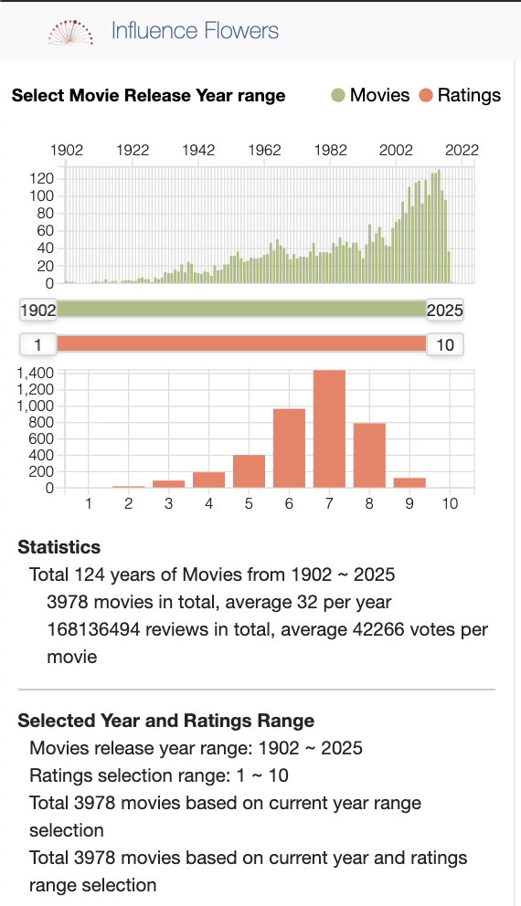
Statistics Panel

Slide 4
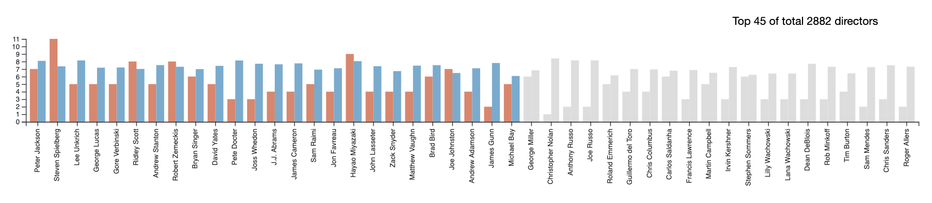
Influence Bar Chart

Slide 5
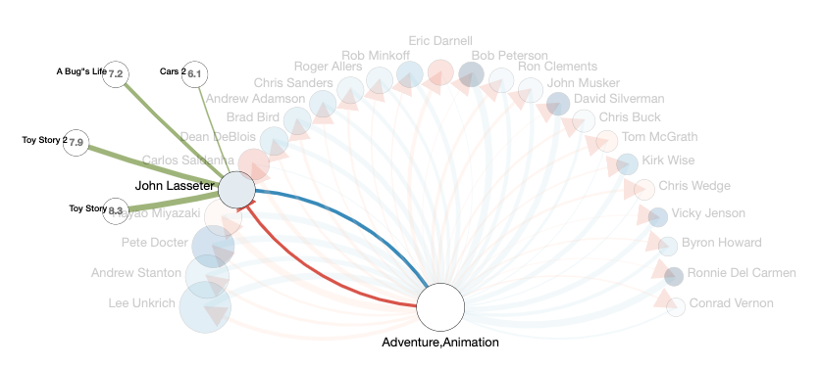
Influence Flower

Slide 6
Extensions

Slide 7
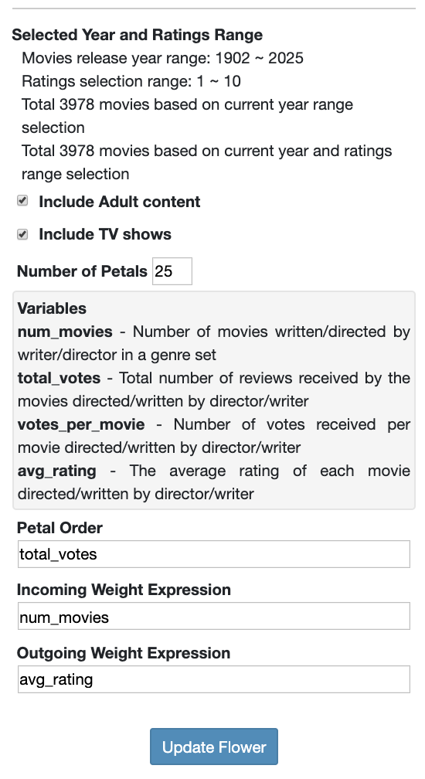
Configurable Influence Expression Extension

Slide 8
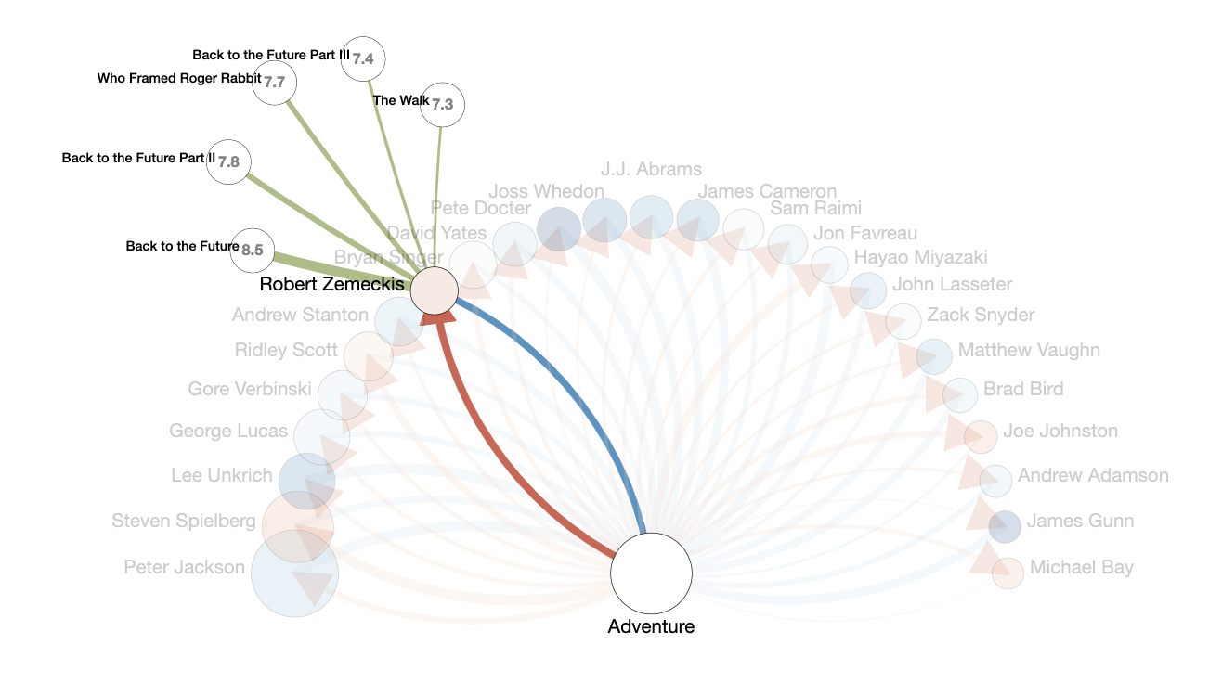
Detail-on-demand Extension

Slide 9
Construction

Slide 10
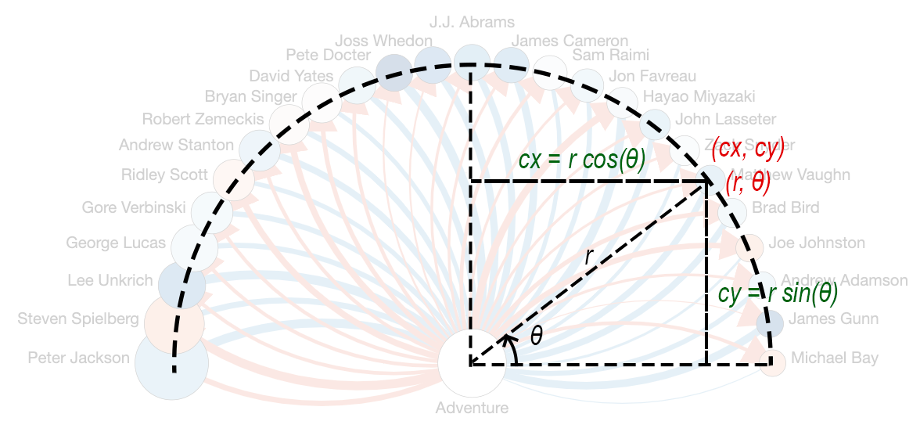
Flower Construction

Slide 11
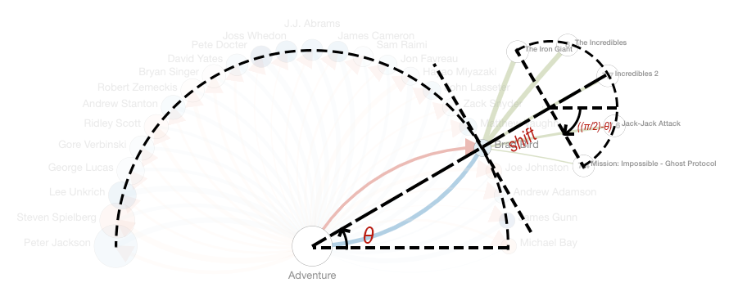
Detail-on-demand Extension Construction

Slide 12
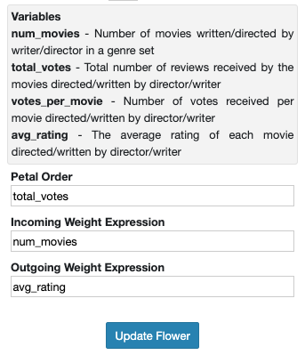
User Configurable Influence Expression Extension Construction
temp_num_movies, temp_avg_rating, temp_votes_per_movie, temp_total_votes = sympy.symbols('num_movies avg_rating votes_per_movie total_votes')
sympy.sympify(config["total_influence"]).evalf(subs={temp_num_movies:director_node["num_movies"], temp_avg_rating:director_node["avg_rating"], temp_total_votes:director_node["total_votes"], temp_votes_per_movie:director_node["votes_per_movie"]})

Slide 13
Thank You

